Slide 1
ECONOMIC SYSTEM OF ISLAM
أَهُمْ يَقْسِمُونَ رَحْمَتَ رَبِّكَ ۚ نَحْنُ قَسَمْنَا بَيْنَهُم مَّعِيشَتَهُمْ فِي الْحَيَاةِ الدُّنْيَا ۚ وَرَفَعْنَا بَعْضَهُمْ فَوْقَ بَعْضٍ دَرَجَاتٍ لِّيَتَّخِذَ بَعْضُهُم بَعْضًا سُخْرِيًّا
PEERAL

Slide 2
defination
According to Ibn Khuldon:
The study of human efforts in obtaining resources and using them through exchange for the fulfillment of the necessities, needs and refinements as well as for the purpose of acquisition
M. Akram Khan:” study of human Falah achieved by organizing the resources of the earth on the basis of co-operation
Hassanuz Zaman: “ the knowledge and application of injunctions and rules of shariah that prevent injustice in the acquisition and disposal of material resources in order to provide satisfaction to human being

Slide 3
capitalism
It is an economic system based on the private ownership of the means of production, distribution and exchange are in private (individual or corporate) hands

Slide 4
Features of capitalism
Existence of unrestricted private ownership of production, exchange and distribution
Economic freedom
Profit motive as incentive
Existence of monopolies
Banking and institution of interest
Wide disparities in distribution of wealth
Economic exploitation of the weak by the strong

Slide 5
Right of ownership
capitalism
Islam
Private ownership
Ownership belongs to Allah

Slide 6
Economic freedom
capitalism
Islam
Unrestricted economic freedom
Allows freedom but not unlimited

Slide 7
monopoly
capitalism
Islam
Competition exists
Forbids unhealthy competition

Slide 8
Institutions of interest
capitalism
Islam
Involved interest in transactions
Interest free
Promotes professionalism

Slide 9
exploitation
capitalism
Islam
Exploitation exists
Exploitation free

Slide 10
Distribution of wealth
capitalism
Islam
Wide economic disparities exist
Fair and just distribution

Slide 11
socialism
Economic system in which the means of production, distribution and exchange are owned by the community collectively through the state.

Slide 12
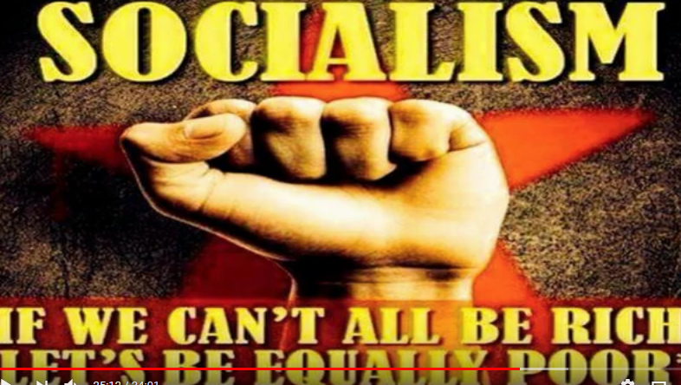

Slide 13
Features of socialism
Public or state ownership of all means of production, distribution and exchange and abolition of private property
Economic equality and provision of basic necessities of life for every one
Materialism and emphasis on economic factors
Suppression of civil liberties

Slide 14
ownership
socialism
Islamic
State ownership
Human and state

Slide 15
materialism
socialism
Islamic
Emphasis on materialism
Eternal+ material life

Slide 16
Economic equality
Socialism
Islamic
Rights of individuals are governed by the principles of state
No equality among human beings
Ensuring equality by zakat and Usher

Slide 17
Quranic teachings regarding economics
No concept of equality in economics
ۚ نَحْنُ قَسَمْنَا بَيْنَهُم مَّعِيشَتَهُمْ فِي الْحَيَاةِ الدُّنْيَا ۚ وَرَفَعْنَا بَعْضَهُمْ فَوْقَ بَعْضٍ دَرَجَاتٍ لِّيَتَّخِذَ بَعْضُهُم بَعْضًا سُخْرِيًّا
We distribute among them their livelihood in the life of this world, and We have exalted some of them above others in degrees, that some of them may take others in subjection
Right of private ownership
يَا أَيُّهَا الَّذِينَ آمَنُوا لَا تَدْخُلُوا بُيُوتًا غَيْرَ بُيُوتِكُمْ
O you who believe! Do not enter houses other than your own houses
تَأْكُلُوا أَمْوَالَكُم بَيْنَكُم بِالْبَاطِلِ لَا
And eat up not one another's property unjustly (in any illegal way e.g. stealing, robbing, deceiving, etc.),

Slide 18
No priesthood
يَا أَيُّهَا النَّاسُ كُلُوا مِمَّا فِي الْأَرْضِ
O ye people! Eat of what is on earth, Lawful and good
Distinction between legal and illegal
يٰٓاَيُّھَا الَّذِيْنَ اٰمَنُوْا لَا تَاْكُلُوْٓا اَمْوَالَكُمْ بَيْنَكُمْ بِالْبَاطِلِ
Exaggeration is not allowed
وَلَا تُسْرِفُوْا ۚ اِنَّهٗ لَا يُحِبُّ الْمُسْرِفِيْنَ

Slide 19
Concept of inheritance
يُوْصِيْكُمُ اللّٰهُ فِيْٓ اَوْلَادِكُمْ ۤ لِلذَّكَرِ مِثْلُ حَظِّ الْاُنْثَيَيْنِ
Concept of public property
الناس شرڪا في ثلاث الما والڪلا والنار،

Slide 20
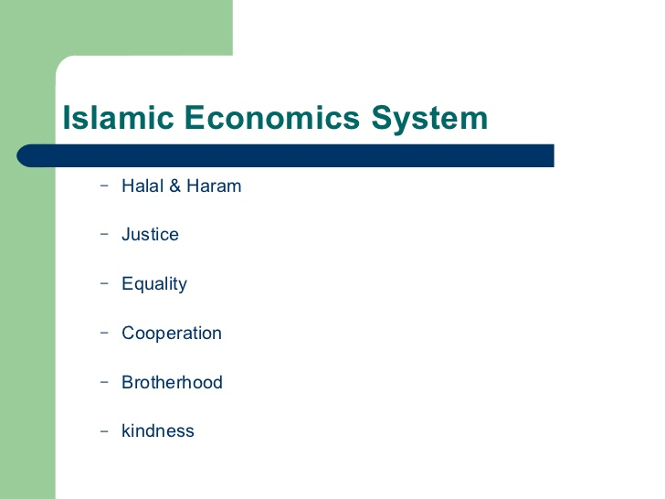

Slide 21
Characteristics of Islamic economics
Alliance with sharih
based on equality
Property right
Possession of wealth
System of zakat
Interest free economy
Taxation system
currency

Slide 22
Four dimensions of the Islamic economic system
IT IS INCUMBENT ON EVERY MUSLIM TO EARN HIS LIVING
EARNING AND SPENDING IS SUBJECT TO CERTAIN LIMITS
MORAL OBLIGATION OF THE RICH TO FULFILL THE NEEDS OF THE POOR
LEGAL OBLIGATION OF THE RICH IN REGARD TO THE POOR

Slide 23
1. It is incumbent on every Muslim to earn his living
HOLY PROPHET (S.A.W) SAID
Next to obligatory prayer(worships) is the obligation of earning an honest living

Slide 24
Earning an honest livelihood is an obligation

Slide 25
No one would eat a food better than one which he took after acquiring it with the labor of his hand”

Slide 26
Begging is condemned in Islam
Prophed said:
“It is all equal that one eats by begging or through ill-gotten property

Slide 27
Cont:
  Charity is lawful neither for the rich nor for the able bodied." (Hadith)
  It is better that a person should take a rope and bring a bundle of wood on his back to sell so that Allah may preserve his honor, than that he should beg from people, (regardless of) whether they give to him or refuse him. (Hadith)

Slide 28
2.
2
Earning and spending is subject to certain limits
EVERY ONE IS FREE TO UTILIZE HIS WEALTH FOR MULTIPLYING IT FURTHER

Slide 29
The freedom to multiply wealth is, of course, not absolutely unrestrained. It is subject to certain heavy moral and legal restrictions:

Slide 30
Six basic conditions of lawful business
Willingness ( for buyer and seller)
Should be halal
Capability ( no minor would be legal to buy and sell)
Possession ( la tabia ma less indak)
Should be owner or be on behalf of owner
Should be clear which is being sold (habl ul habal)

Slide 31
All the lawful avenues of earning a livelihood are open to every one. In economic field body has equal opportunities of struggle. No monopoly of any kind exists. Every body is free to choose a profession of his own liking and aptitude.

Slide 32
All things in the earth and space, in the creation of which man has not subscribed, can be utilized by all in accordance with their need
Prophet (S A W) said:” all Muslims have equal share in three things; water , grass and fire

Slide 33
“Any one who cultivates a barren land, he becomes its owner”
“the one who keeps the land uncultivated for three years will have no claim over that land”

Slide 34
(MAN GUSSH FA LESS MINNA)
He who deceives is not one of my people

Slide 35
Taking of false oath for the purpose of increasing sale is also a sin

Slide 36
Business involving usury (interest) is in any form forbidden

Slide 37
No such partnership is permissible in which profit of one partner is guaranteed but of the other is not

Slide 38
Gambling is an unlawful and impious act

Slide 39
Trade of all such things is also forbidden which have been held unlawful for eating and drinking

Slide 40
In business such methods which harm others, or the society as a whole, are also not permissible

Slide 41
3-
Moral obligation of the rich to fulfill the needs of the poor

Slide 42
وَفِيْٓ اَمْوَالِهِمْ حَقٌّ لِّلسَّاۗىِٕلِ وَالْمَحْرُوْمِ
(WA FEE AMWALEHIM HAQ LIS SAEL WAL MAHROOM)
and in their wealth, the baggers and out cast had due share

Slide 43
خُذْ مِنْ أَمْوَالِهِمْ صَدَقَةً تُطَهِّرُهُمْ وَتُزَكِّيهِم
Take, [O, Muhammad], from their wealth a charity by which you purify them and cause them increase

Slide 44
لَنْ تَنَالُوا الْبِرَّ حَتّٰى تُنْفِقُوْا مِمَّا تُحِبُّوْنَ
( LAN TANAAL UL BIR HATTA TUNFEQO MIMA TUHIBOON)
You will not attain to piety until you spend of that which you love

Slide 45
4. LEGAL OBLIGATION OF THE RICH IN REGARD TO THE POOR

Slide 46
If the amount recovered as zakat and tithe does not suffice for the needs of the poor and other religious requirements, the government has right to levy(charge) additional tax on the rich

Slide 47
When a Muslim dies his property is distributed among his nearest relatives,
this system also helps the circulation of wealth

Slide 48
Legal and lawful sources of income
Business
Agriculture
Employment
Industry
Daily wages

Slide 49
Illegal and unlawful sources of income
Thievery
Looting
Interest
Cheating in scaling
Greasing palm
Hoarding
Mixing
Sailing of wine, heroin etc
debauchery

